Slide 1
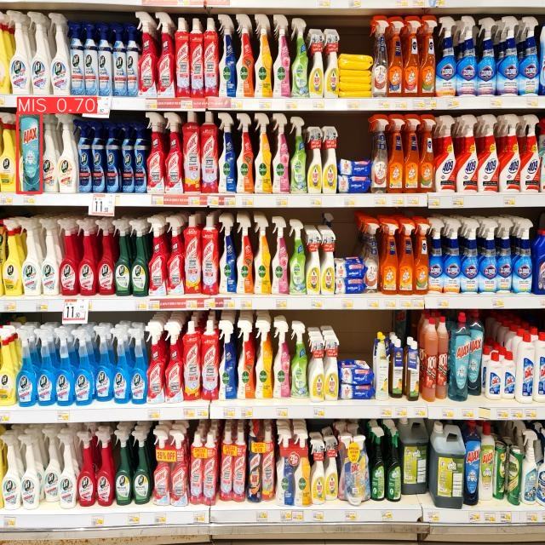

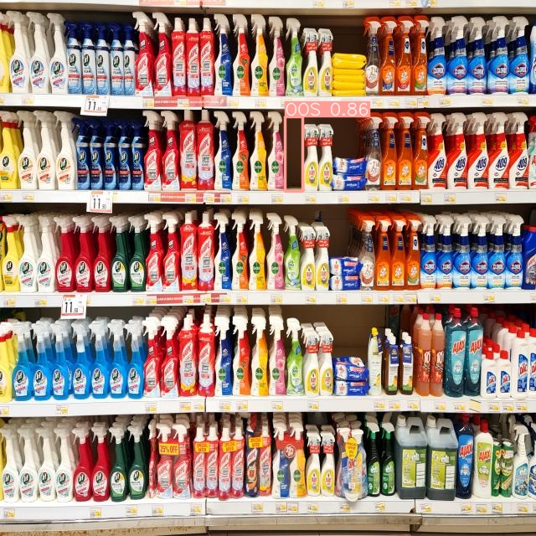
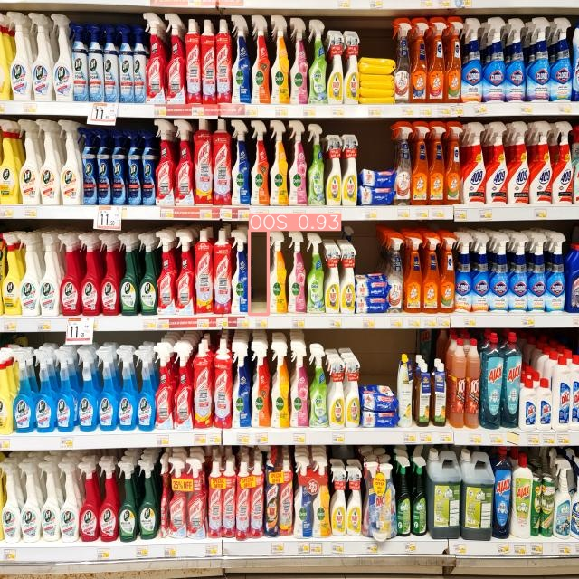
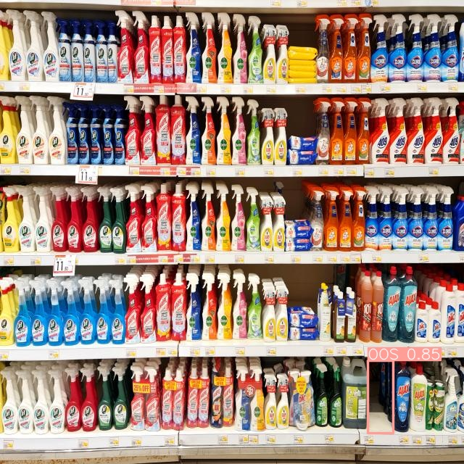
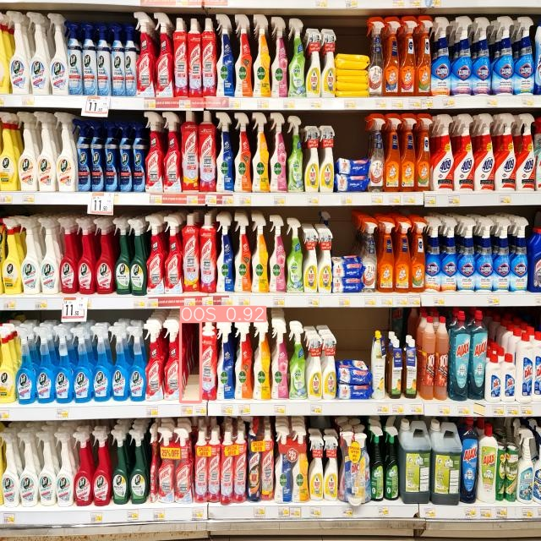
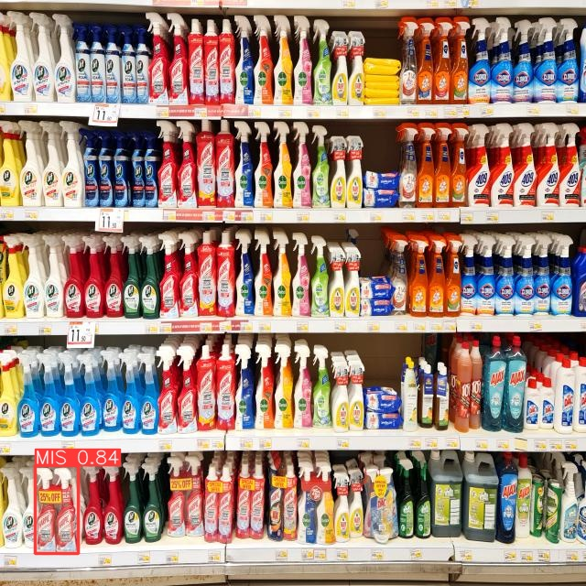
231-ICS-619 Project Video-based Retail Store Shelf Monitoring
Khaled Almutairy
Mamoun Alghaslan
Notes:
Hello
Welcome to the video based retail store shelf monitoring
My name is Mamoun Alghaslan, and I am delighted to show you our Shelf Monitoring System, which I worked on with my team mate Khaled Almutairy
This project is prepared as part of the requirements for the ICS-619 for the professional master in artificial intelligence from KFUPM with the mentorship of Dr. Elsayed and Dr. AbdulJabbar.

Slide 2
Introduction
Recent trends in retail focus on AI-Powered shops, such as Amazon Go, Grabango, and Walmart’s Intelligent Retail Lab
Our proposed projects aims to build a robust Shelf-Monitoring-System (SMS) to tackle Out-of-Stock (OOS) and Misplaced (MIS) items
Key components include a sliding camera system mounted on the opposing sides of shelves, connected to a web server that hosts a detection model, and a notification system that can provide real-time updates

Slide 3
Our prototype
Collected & labelled images from Danube supermarket
Experimented with YOLOv5 and v7, & Fine-tuned YOLOv8 on the dataset
Built a simple web interface to the object detection model

Slide 4
Existing Solutions
Deep Learning methods
Other methods
Faster R-CNN
A two-stage architecture, first generating region proposals and then predicting class labels, and bounding box coordinates
Generally slower due to its two-stage process
YOLO
A single-stage architecture, simultaneously predicting class probabilities and bounding box coordinates in one pass through the network.
Known for its real-time object detection capabilities, achieving faster inference speeds.
Classical Methods
Do not generalize well when applied to new environments.
Depth Estimation Method
Fail to detect product misplacement

Slide 5
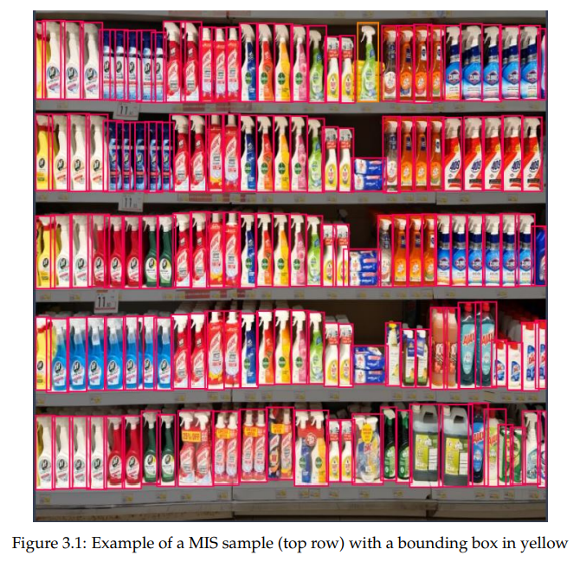
Data Collection
Danube Supermarket
Focused on five shelves ~150 products
Each product was removed to simulate OOS, and 32 product were moved around five times to simulate MIS
A total of 310 images were collected and augmented
Data set was split 90/5/5%, with 15 samples of OOS and MIS in val./test
Roboflow for annotation

Slide 6
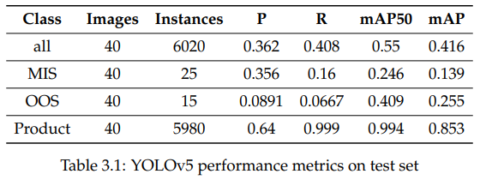
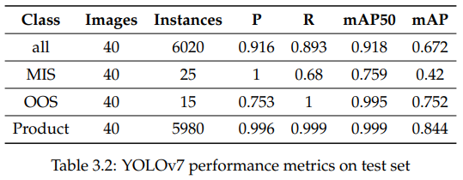
Experiments
YOLOv5
YOLOv7
Paperspace Jupyter Notebook, Quadro-P6000 GPU, 5- and 2.5-hours training time respectively

Slide 7
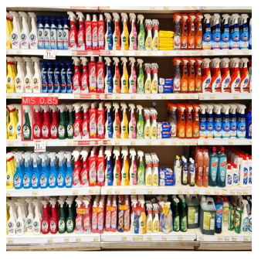
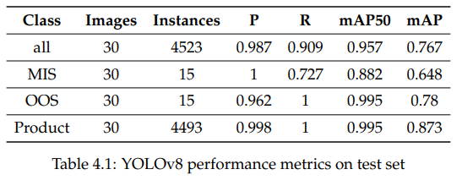
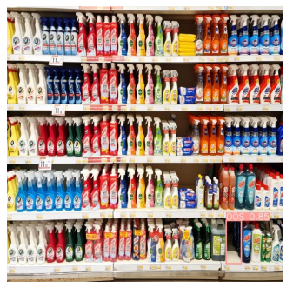
Model fine-tuning
YOLOv8s
Results

Slide 8
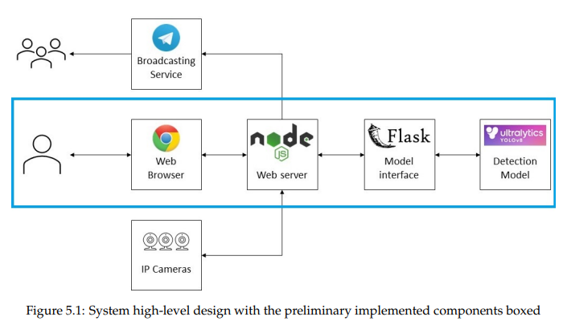
System Design
Components
Diagram
Detection model
Model API [Python + Flask]
Web Server [Node.js + Express]
Web-site server
Web worker
Broadcasting service
IP Cameras

Slide 9
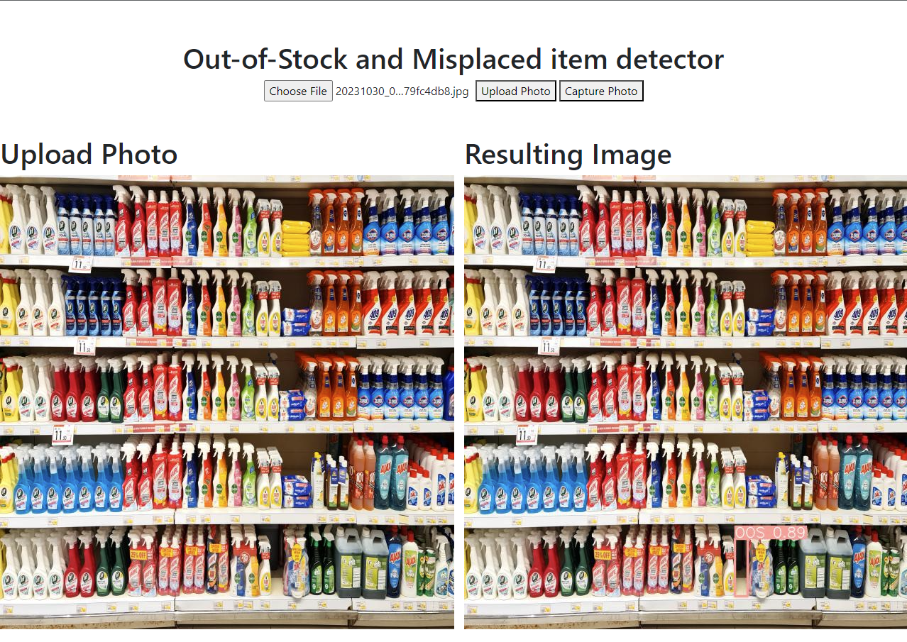
Prototype

Slide 10
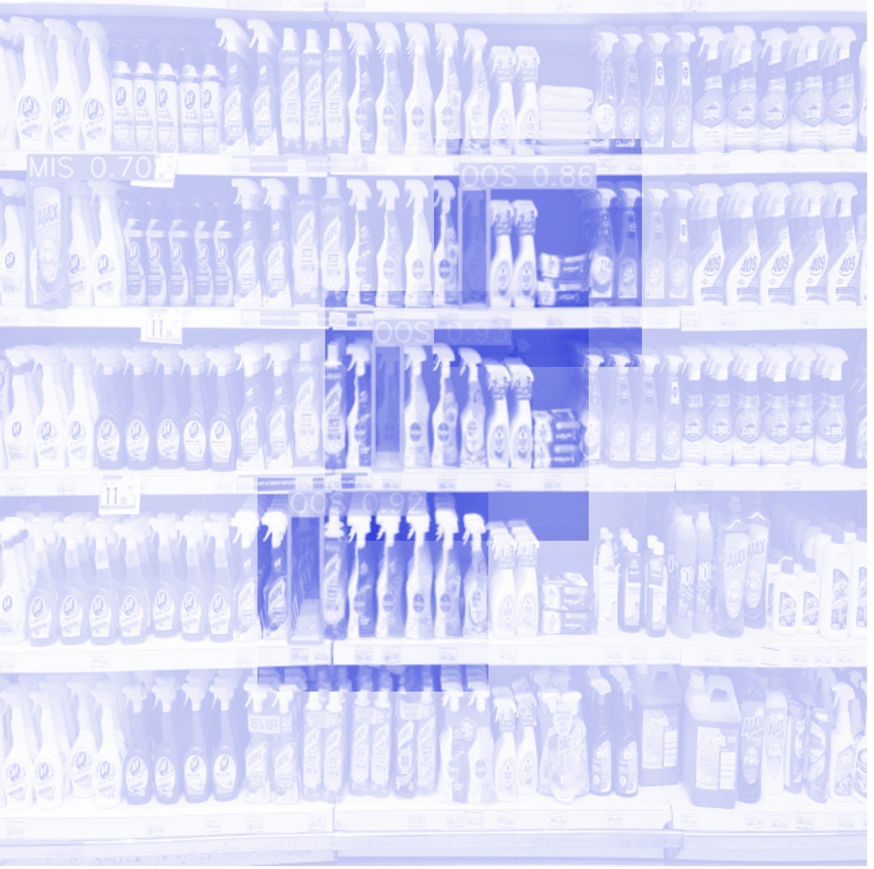
Conclusion
Collected and labelled a new dataset from Danube supermarket for Out-Of-Stock (OOS) and product misplacement (MIS).
Fine-tuned an existing model and achieved mean Average Precision (mAP) of 0.882 for MIS and 0.995 for OOS.
Developed a preliminary prototype of the Video-based Retail Store Shelf Monitoring System (SMS) using deep learning as a proof-of-concept.

Slide 11
Future work
Real-world testing in a supermarket
Refining accuracy by expanding the dataset
Scaling the system to include multiple IP-cameras
Exploring broadcasting services

Slide 12
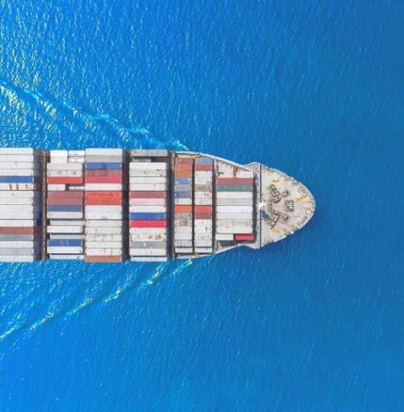
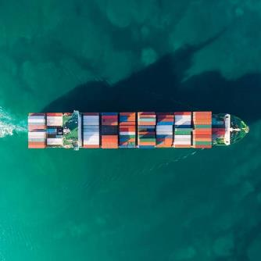
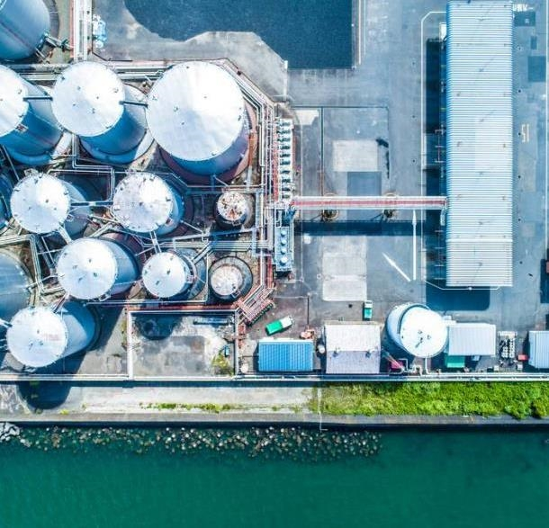
THANK YOU
Mamoun Alghaslan, Khaled Almutairy

